Slide 1
Words To Go!
Made by Grace Jaundalderis & Viktoria Crawford

Slide 2
Base/Root Words
Base Word: A whole word that can be used to make other words.
For example: Agreement, agreeable, and disagreement all contain the base word agree.
Root Word: the main part of a word that is not part of a whole word.
For example: the root word for auditorium is aud, which means to hear.

Slide 3
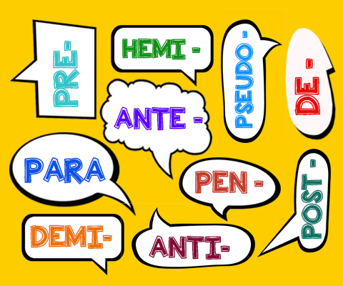
Prefixes
Definition: a word that is added to the beginning of a base word or a root word and changes its meaning in some way.
For example: adding en to courage creates encourage, en is the prefix.

Slide 4
Suffixes
Definition: A suffix is a morpheme added at the end of a word to form a derivative
For Example: ing is the suffix for Run-ing

Slide 5
Homographs
Definition: they have the same spelling but different meanings.
For Example: mole: mean spot on your face; or small burrowing mammal
object
A thing you can See or touch
A goal
A noun that receives the action of a verb

Slide 6
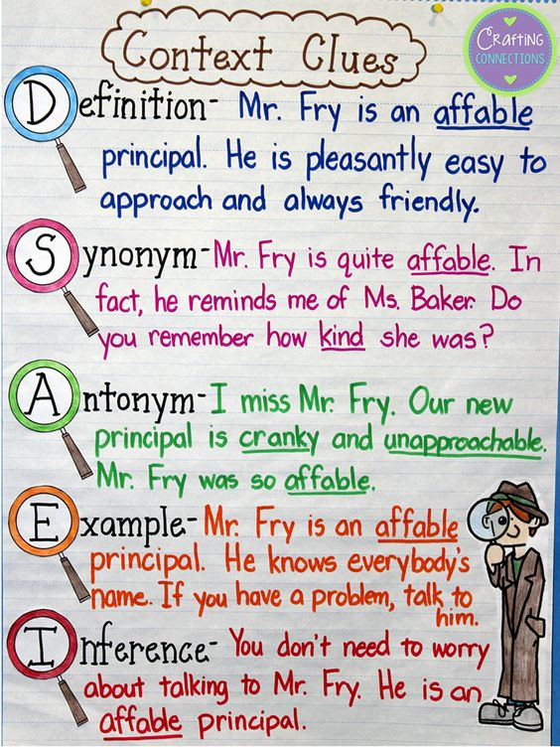
Context Clues
Definition: hints that an author gives to help find the meaning of a word.
For example:

Slide 7
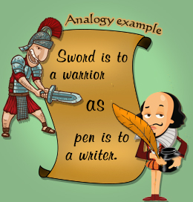
Analogies
Definition:
For Example:
A way to compare things that have similar relationship’s
Synonyms: beautiful : attractive
Antonyms: likely : unlikely
Part to whole: shade : lamp
Place: couch: living room
Characteristic: shirt : sleeve
Object and purpose: scissors : cut
Example: horse : animal
Manner: tiptoe : walk
Degree or intensity: great : amazing
Grammatical: he : his

Slide 8
The End
https://play.kahoot.it/#/?quizId=bb4d3775-a36b-4330-8862-f464ddcc9058

