Slide 1
The One and Only You!

Slide 2
My Story
My childhood and bullies “Gretchen is a big fat pig”
Lifetime challenges and accomplishments
Fitness
Food
Mental wellbeing
Why I am here
Wellness coaching

Slide 3
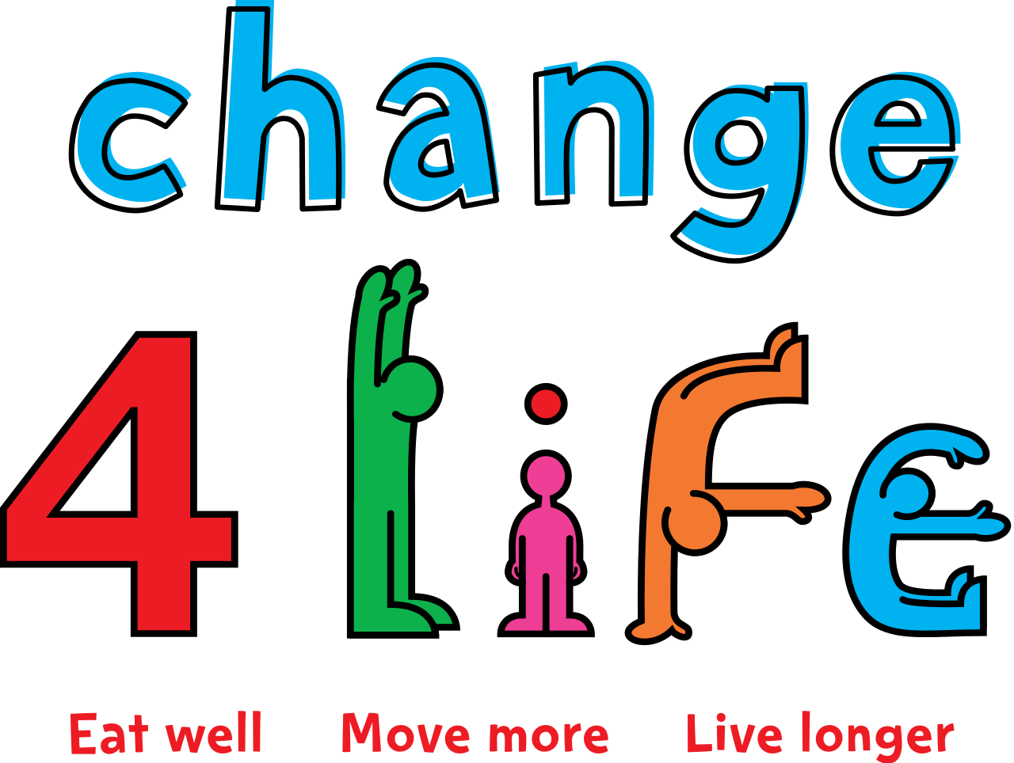
Top Four Tips
Drink more water
Exercise
Get good sleep
Eat less sugar

Slide 4
Drink more water
Water is amazing for our bodies
Our bodies need water to survive – we are half water!
When your body doesn’t have enough water, your muscles, cells and organs will not function correctly
Drink at least 8 glasses of water each day

Slide 5
Exercise
Get your body moving and get your heart rate up!
Builds muscles, strength and coordination
Good for your mind, makes you feel good
Helps you maintain good weight which is important in fighting long-term disease
Let’s move!!

Slide 6
Get good sleep
It’s important to let your muscles rejuvenate – this includes your brain
Getting a good night’s rest helps you think more clearly and have great energy for each new day

Slide 7
Let’s talk about SUGAR
We are Addicted!
Sugar definition
Types of Sugar
Sugar foods
What your body thinks of sugar
What happens when you eat too much sugar?
Daily recommended sugar intake
How much sugar do you eat each day?

Slide 8
We are addicted!
While we need sugar for energy, the excess sugar found unexpectedly in foods and beverages, helps us consume more than we should, which leads us to cravings and impulsive eating. This is addiction…plain and simple.
A recent study by the American Health Association found:
Children aged 1 to 3 years old consume nearly 12 teaspoons of sugar a day – well beyond the maximum recommended daily intake of 4 teaspoons.
Children 4 to 8 years old consume an average of 21 teaspoons a day. The maximum recommended daily intake is 4 teaspoons!!
Teens 14-18 years old intake the most sugar on a daily basis, averaging about 34.3 teaspoons.
A study conducted in 2001-2004 by the National Health and Nutrition Examination Survey found the average American consumes about 22.2 teaspoons daily. That is about triple the recommended amount! That’s 130 pounds a year!!

Slide 9
Sugar Definition
Sugar is the generic name for sweet, soluble carbohydrates, many of which are used in food.
There are various types of sugar derived from different sources. Simple sugars are called monosaccharides and include glucose (also known as dextrose), fructose, and galactose.
The "table sugar" or "granulated sugar" most customarily used as food is sucrose.
Sugar is used in prepared foods like cookies and candies, and it is also added to meats, sauces, soups and chips!

Slide 10
Different Names for Sugar
Agave
Barley Malt
Brown rice syrup
Brown sugar
Cane crystals
Cane juice
Cane sugar
Carob Syrup
Caramel
Coconut sugar
Corn sweetener
Corn syrup
Crystalline fructose
Date sugar
Dextrose
Evaporated cane juice
Fructose
Fruit juice concentrates
Glucose
High-Fructose corn syrup
Honey
Invert sugar
Lactose
Maltose
Malt syrup
Molasses
Raw sugar
Rice bran syrup
Rice syrup
Sorghum
Sucrose
Sugar
Syrup
Turbinado Sugar
Lactose
Maltose

Slide 11
Types of Sugar
Simple Sugars
Fructose
Glactose
Sucrose (combined Glucose and Fructose)
Glucose (Dextrose)
Granulated Sugar
Table Sugar
Maltose (from Malted Grains)
Lactose (from Milk)

Slide 12
Sugar Substitutes
Aspartame
Sucralose (chlorinated derivative of Sucrose)

Slide 13
Where does Sugar come from?
Sugars are found in the tissues of most plants
Most of the commercial sugars come from sugar beets and sugar cane.

Slide 14
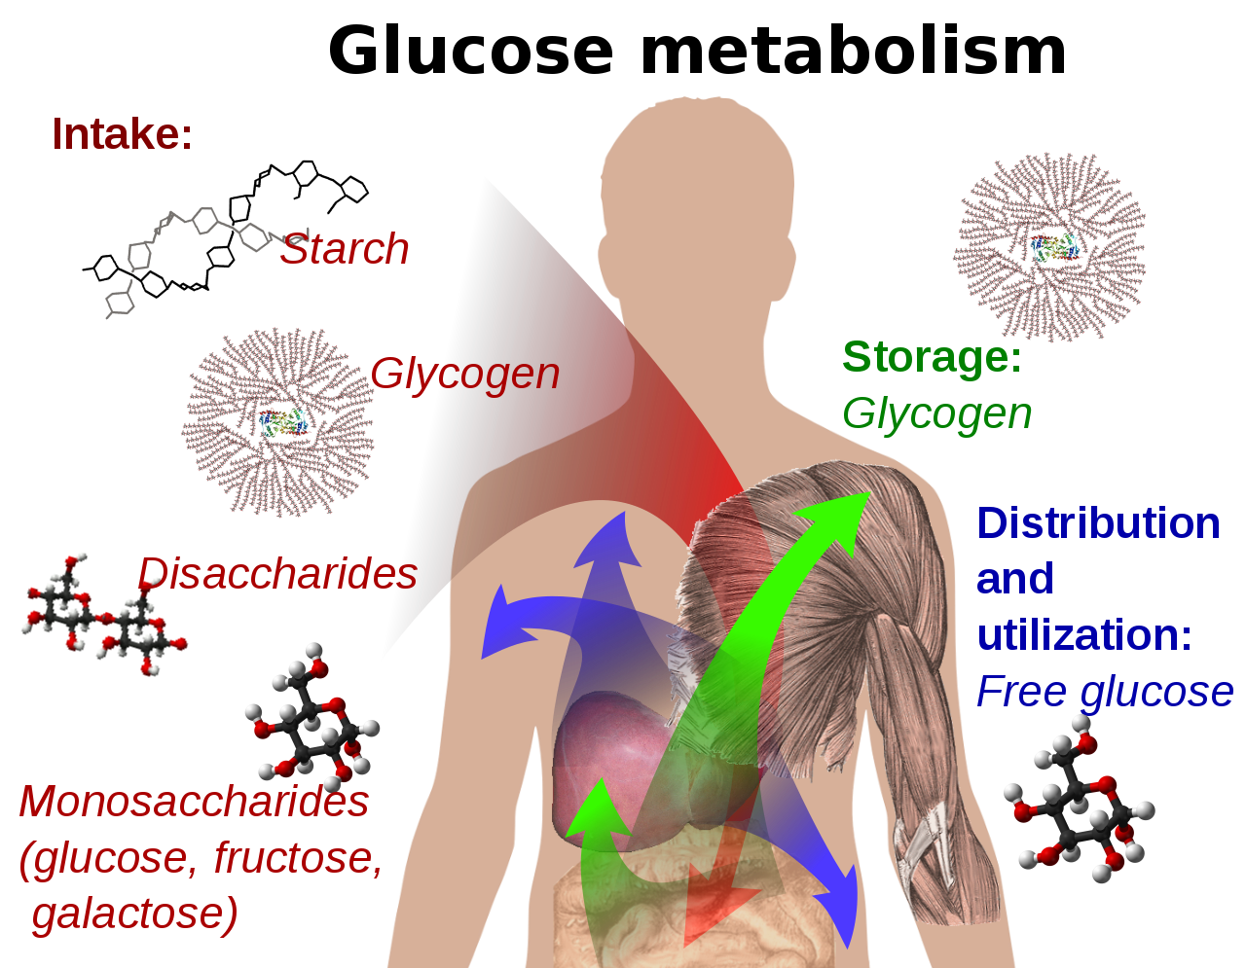
What your body thinks of sugar
We need nutrient-rich carbohydrates for energy.
In the body, sucrose is converted into the simple sugars fructose and glucose.
Glucose is said to be the “energy of life” because every cell in our body uses Glucose as it is processed in the body.
Fructose can only be processed by our liver and therefore eating too much can be toxic to our bodies.
The average person consumes about 53 pounds of sugar each year!

Slide 15
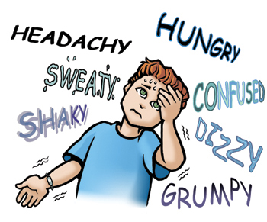
What happens when you eat too much sugar?
Eating too much sugar has been linked to long-term obesity, diabetes, cardiovascular disease, dementia, and tooth decay. Do these short-term effects sound familiar?
Short Term
Mood Swings
Fatigue
Muscle Weakness
Extreme sugar highs/lows
Unrestful Sleep
Acne
Long Term
Depression Anxiety
Vision Impairment
Substance Abuse
Insulin resistance Type 2 Diabetes
Insomnia
Eczema Psoriasis

Slide 16
Sugar’s Vicious Circle
Insulin Spike
Drop in Blood Sugar
Moody / Hangry
“False Hunger” for quick carbs/sugar
Eat Sugar

Slide 17
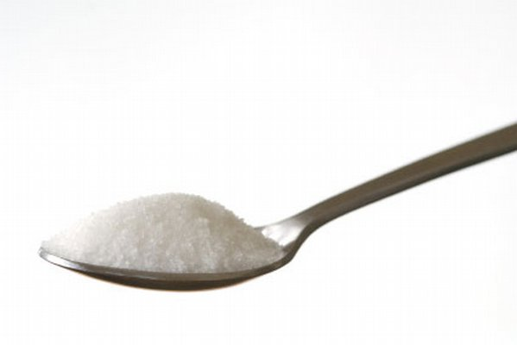
Daily Recommended Sugar Intake
AHA guidelines
The American Heart Association (AHA) releases guidelines limiting the amount of added sugar considered acceptable for a healthy diet. Their guidelines also connected increased sugar consumption with a variety of health problems, including obesity and high blood pressure.
The latest guidelines states that kids pre-teen and teen years, the maximum amount of added sugar included in their daily diet should be 5 to 8 teaspoons.

Slide 18
How much sugar do you eat each day?
Did you know you need 7-8 cups of water each day?
Milk is a great alternative! It gives you calcium and nutrients your growing body needs. 3 cups a day!
Not a great alternative when your body needs fluids. If you like flavors in your water, try adding fresh lemon, lime, orange or cucumber slices.

Slide 19
Eat this, not that!

Slide 20
Eat this, not that!

Slide 21
Eat this, not that!
Just don’t ☺

Slide 22
Are you ready for a Challenge?

Slide 23
Let’s start with a couple of small changes:
Water Challenge: Put a 16 oz. water bottle in the bathroom and each morning, drink a full bottle of water shortly after you wake up.
Exercise Challenge: Stretch before you go to bed each night.
Sleep Challenge: Get at least 8 hours of sleep each night.
Sugar Challenge: Reduce your sweet treat (candy, cookie, soda) to one per day and eat it before 1:00 p.m.
Document your daily results and share with me next week for a special prize!

Slide 24
Thank You!
Next time we’ll start looking at labels, identifying added sugars, maybe a little cooking and definitely new challenges and rewards for the previous challenge!

