Slide 1
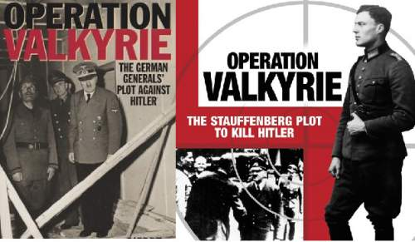

Slide 2
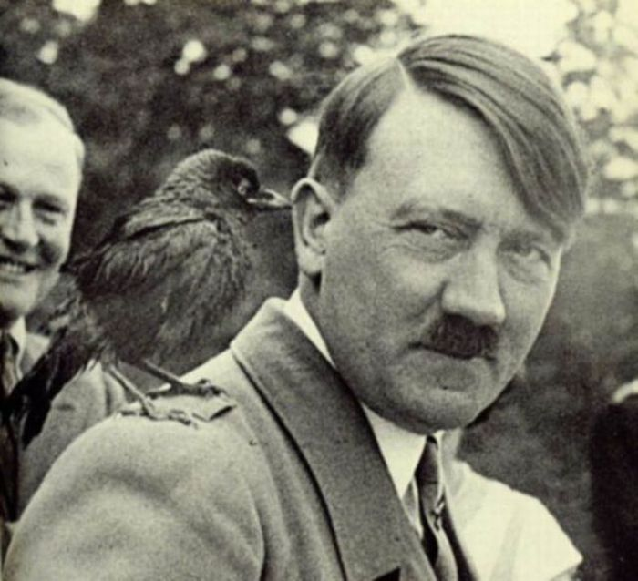
Background
The year was 1944 and World War ll was raging all over Europe. The German dictator Hitler was despised by many of his generals due to the atrocities that he had committed throughout the war.

Slide 3
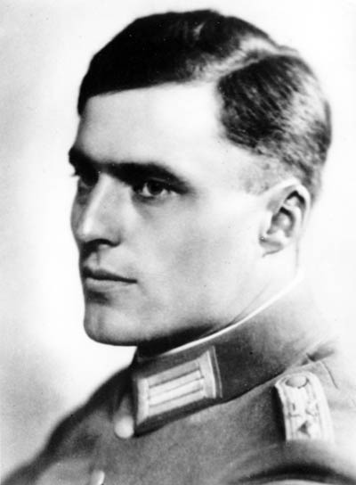
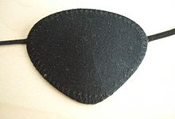
Claus Von Staufenburg
There was a general who disliked Hitler the most, who knew that Hitler needed to be stopped and the war needed to end, his name was Claus Von Stauffenburg. He had once served a tour in Africa where he survived being bombed and had to wear an eye patch for the rest of his life!

Slide 4
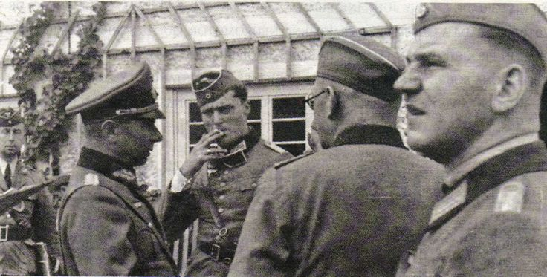

Slide 5
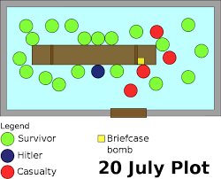

Slide 6
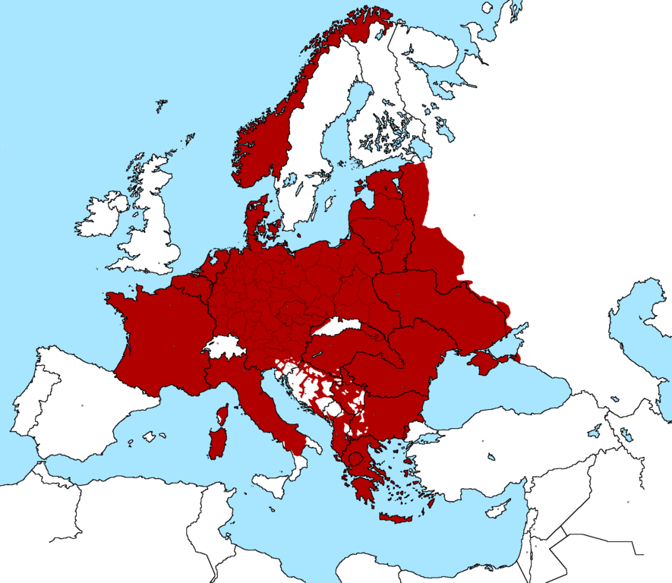
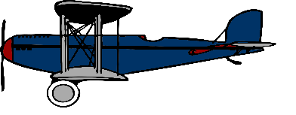

Slide 7
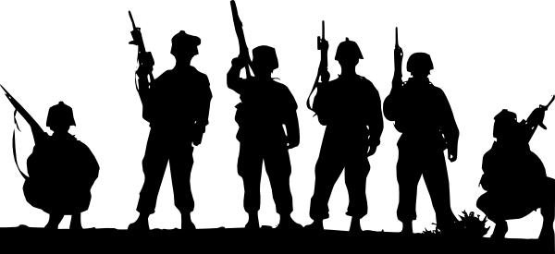
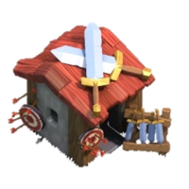

Slide 8
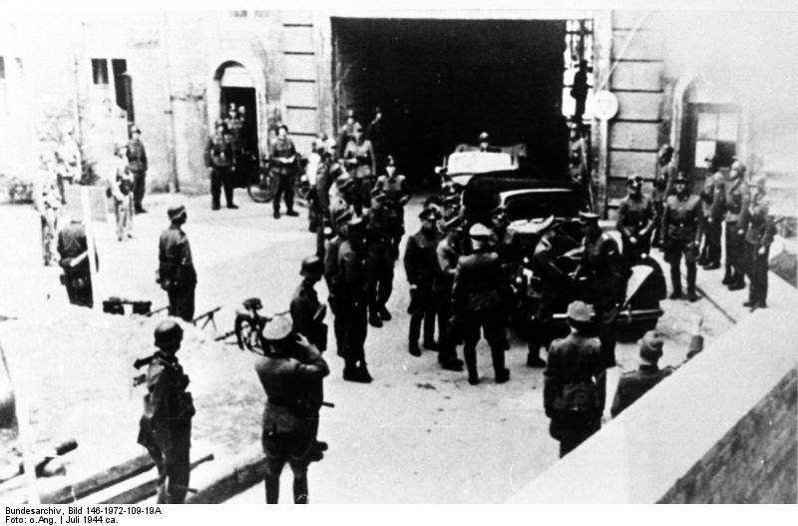
The coup begins
The coup began and the reserve army that was being led by Staufengurg first took over the Nazi barracks with ease. Everyone thought Hitler was dead.

Slide 10
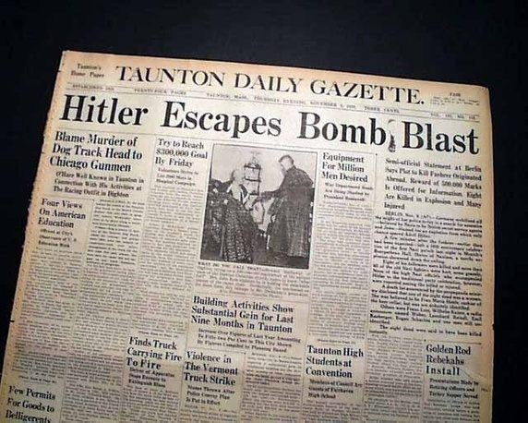
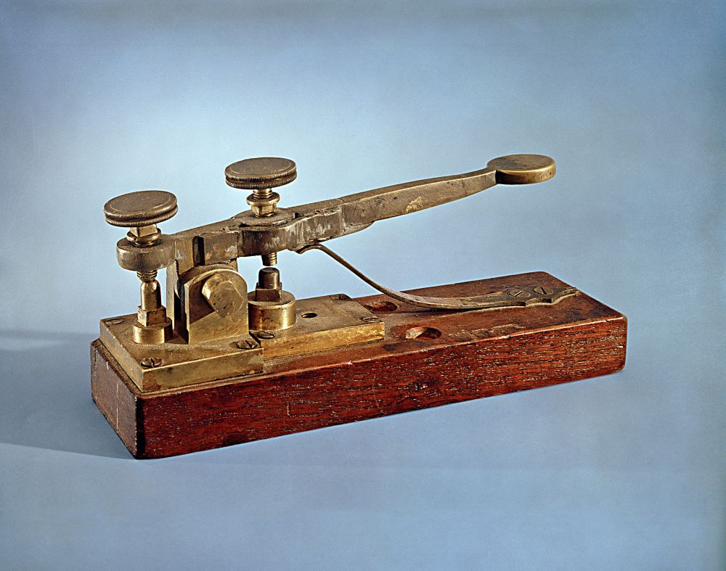

Slide 11
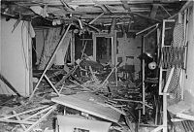
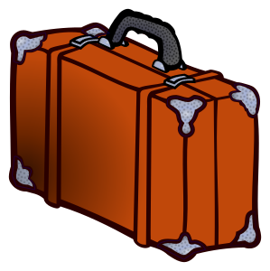

Slide 12
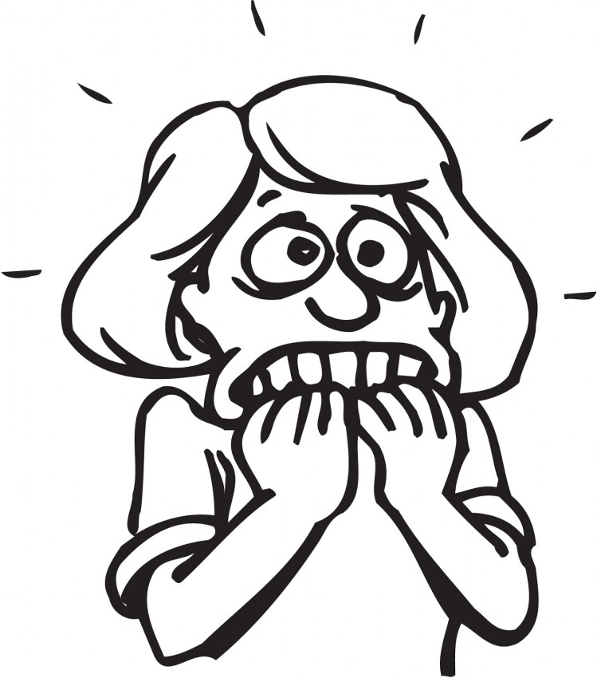

Slide 13
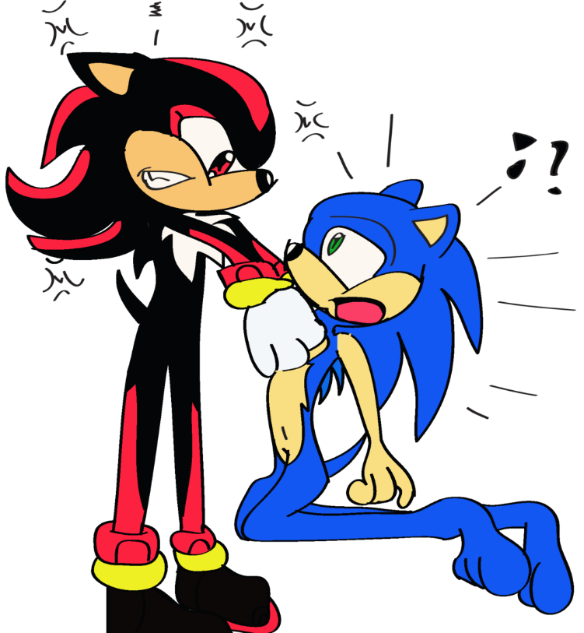

Slide 15
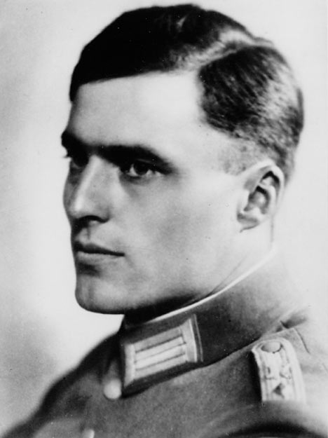
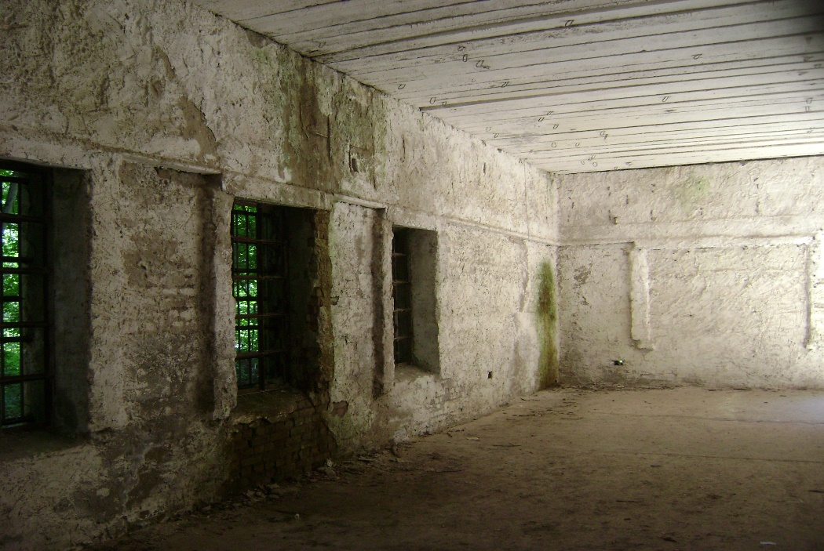

Slide 16
Questions, comments, concerns?

Slide 17
Sites
(www.dw.com), Deutsche Welle. "Germany Remembers Operation Valkyrie, the Plot to Kill Hitler | Germany | DW.COM | 20.07.2011." DW.COM. N.p., n.d. Web. 15 Oct. 2016.
"20 July Plot." Wikipedia. Wikimedia Foundation, n.d. Web. 16 Oct. 2016.
"World War II Resistance: Operation Valkyrie - The "July Plot" to Assassinate Hitler." Operation Valkyrie. N.p., n.d. Web. 16 Oct. 2016.

