Slide 1
Katarina
Please read the summary of the book on the back for background knowledge

Slide 2
If you don’t have the book on you
It is 1942, and eight-year-old Katarina’s carefree life in Slovakia is about to change. Jews are being rounded up, and Katarina and her aunt Lena and her uncle Teo are in danger. Katarina does not understand why she is considered Jewish since her family has never been observant, but she trusts her beloved aunt to keep her safe.
Frustrated and scared, Katarina is forced to hide in a peasant household. The weeks turn into months, and Katarina waits anxiously for her aunt to come for her. Because of Katarina’s red hair, she is distrusted by the superstitious villagers, and when her Judaism is discovered, she is asked to leave. Katarina wanders alone from village to village, constantly at risk because of the persecution of Jews in her country, and confused by the threats that hangs over her.
Throughout her plight, Katarina’s spirit is maintained by a fierce belief that everything and everyone she once loved will await her at the end of the war.

Slide 3
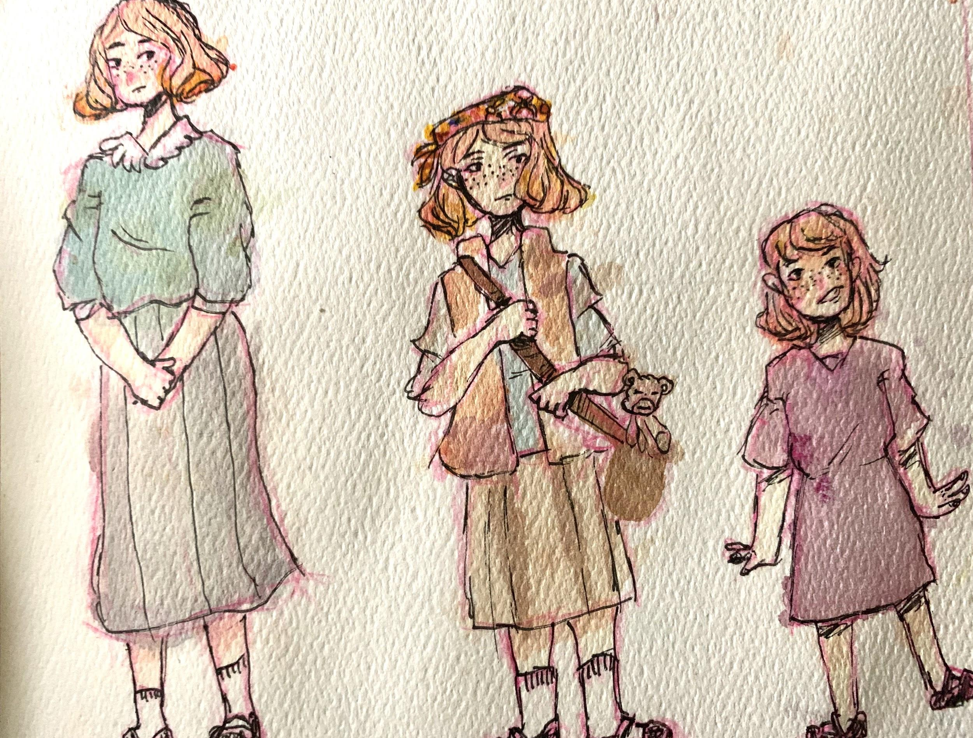
Katarina
Katarina is our main character. I illustrated her three times to represent her ageing throughout the book. The version of Katarina in the middle is the most book accurate. There was more info on her appearance during the age of nine through ten. The tallest version of Katarina I based on the cover except I changed her hair to red because the book seems to likes telling us how abnormal to have a person with red hair and freckles.

Slide 4
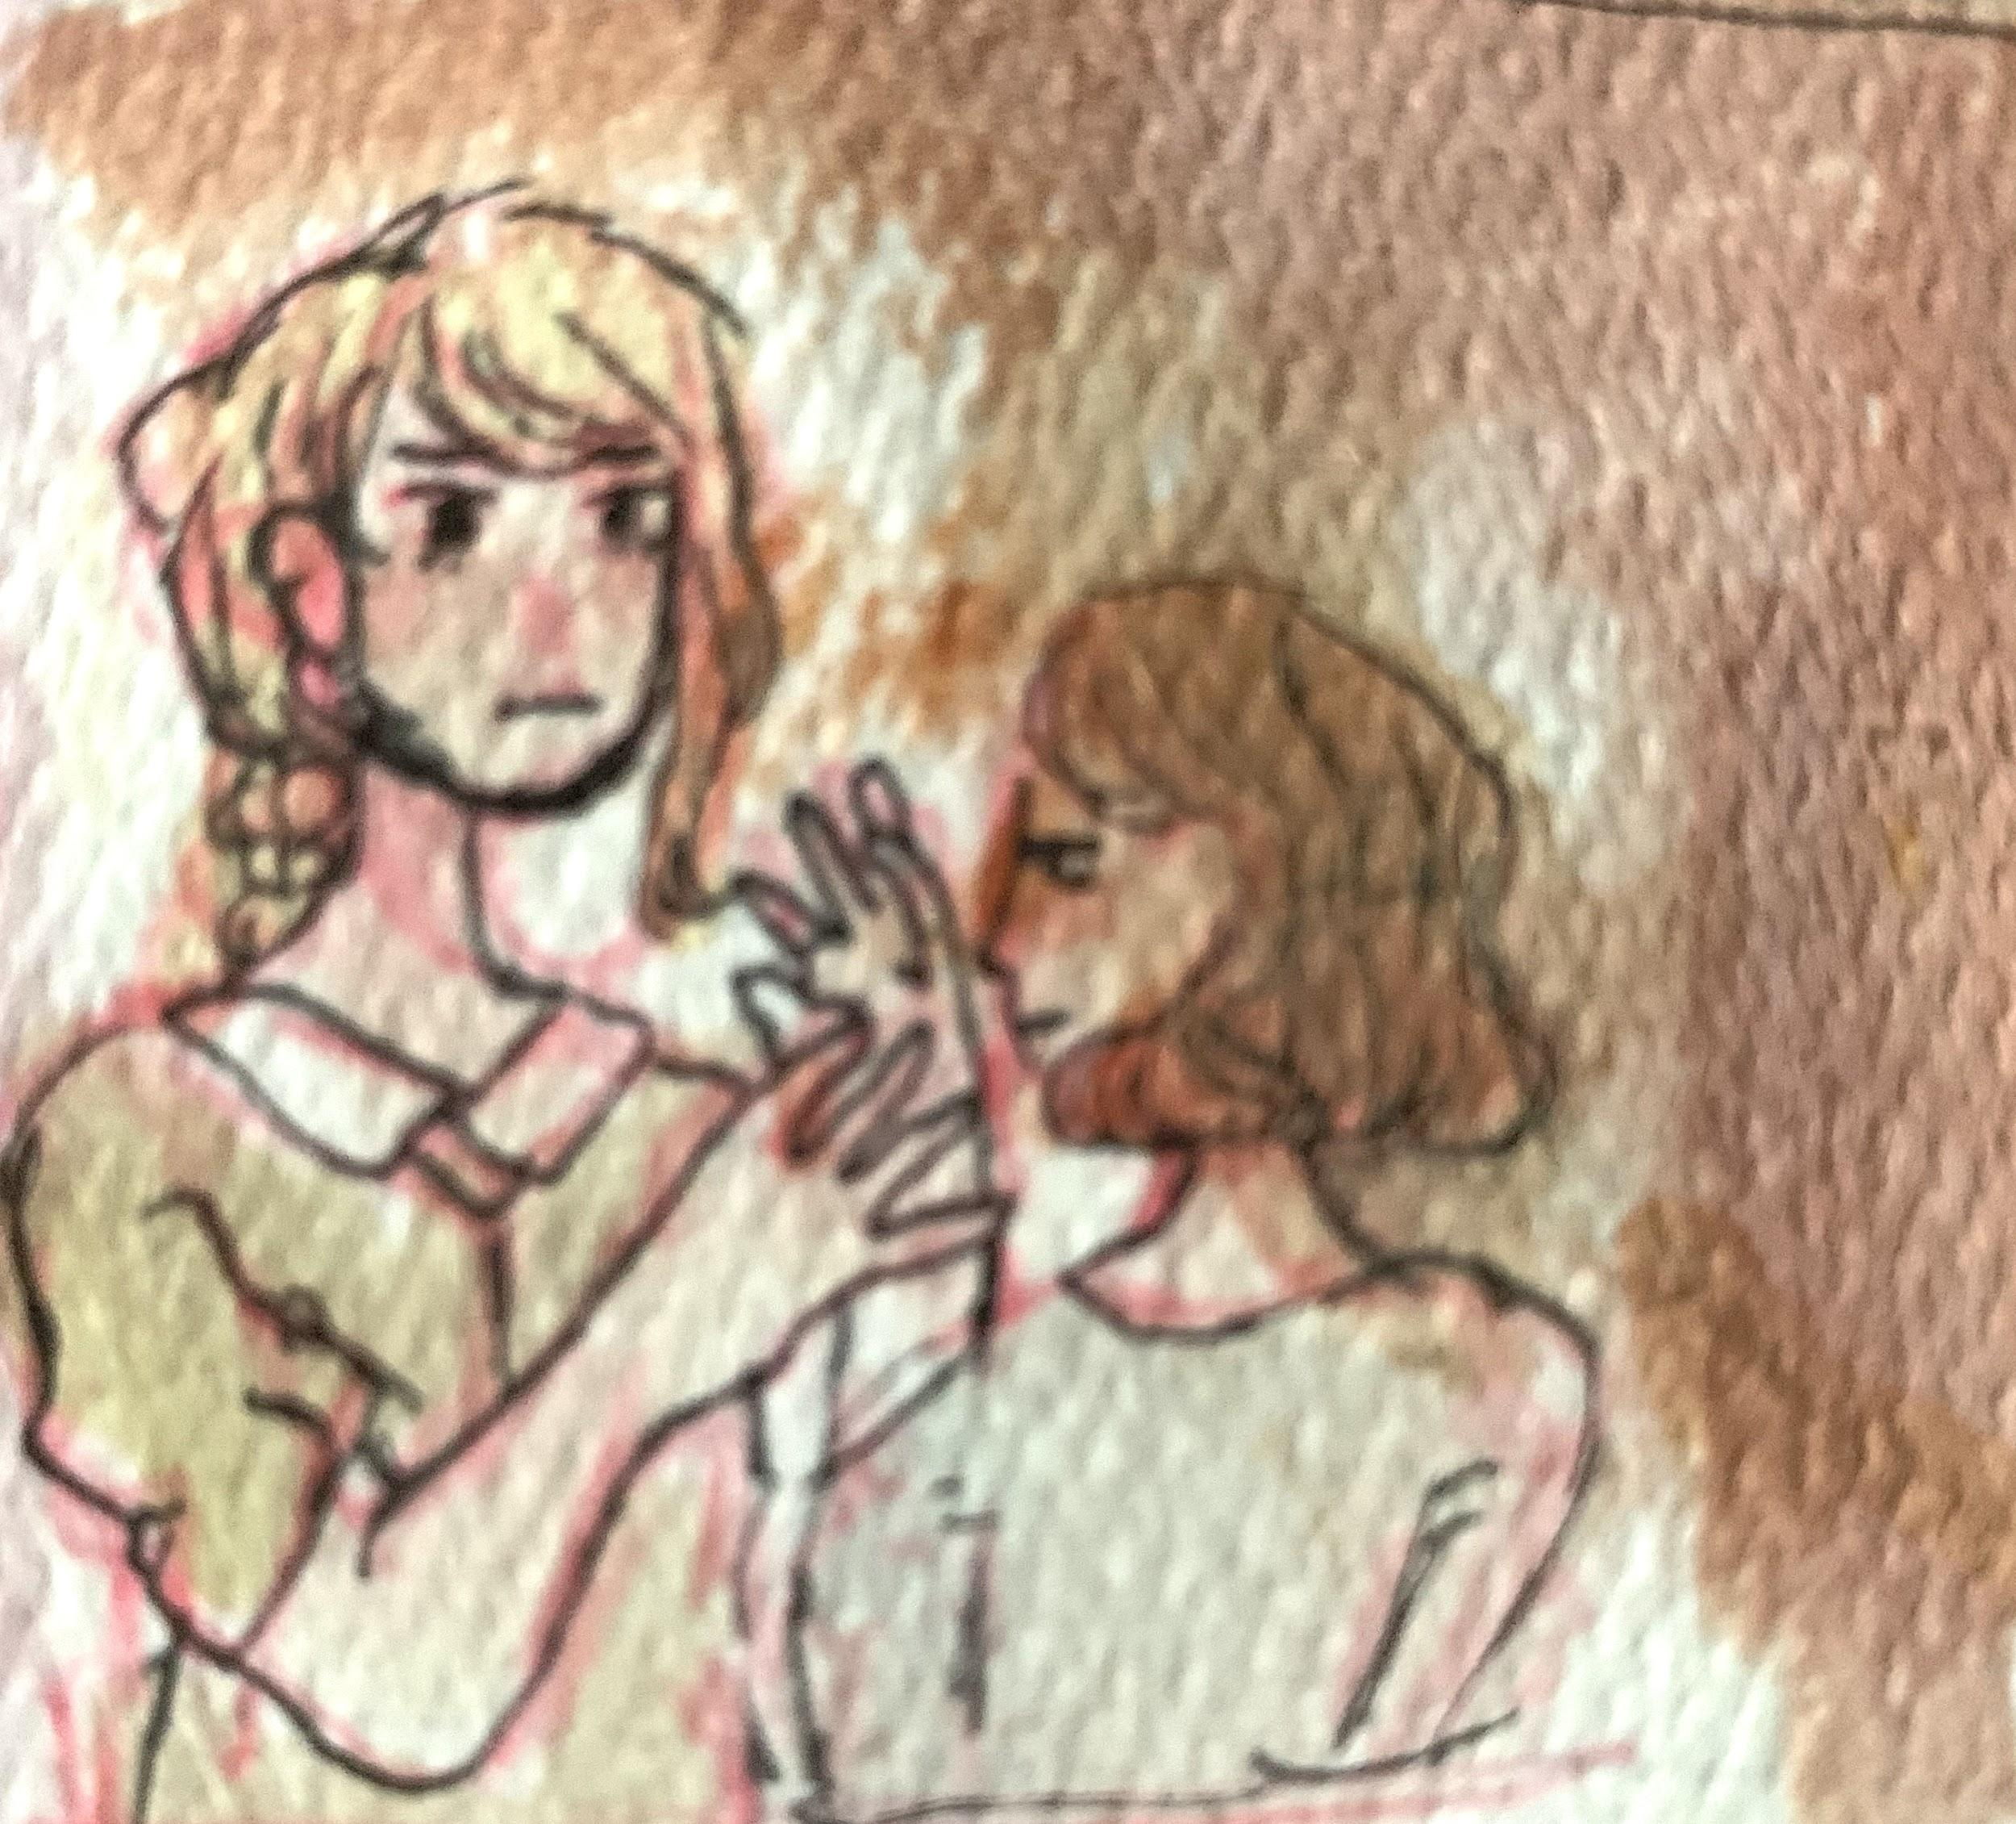
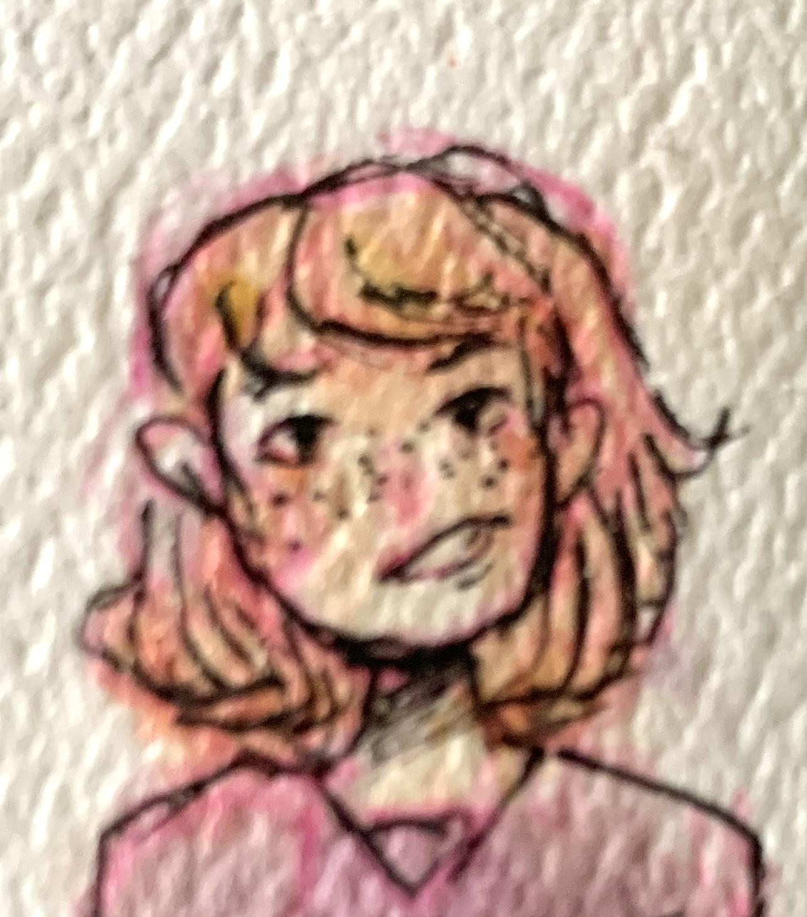
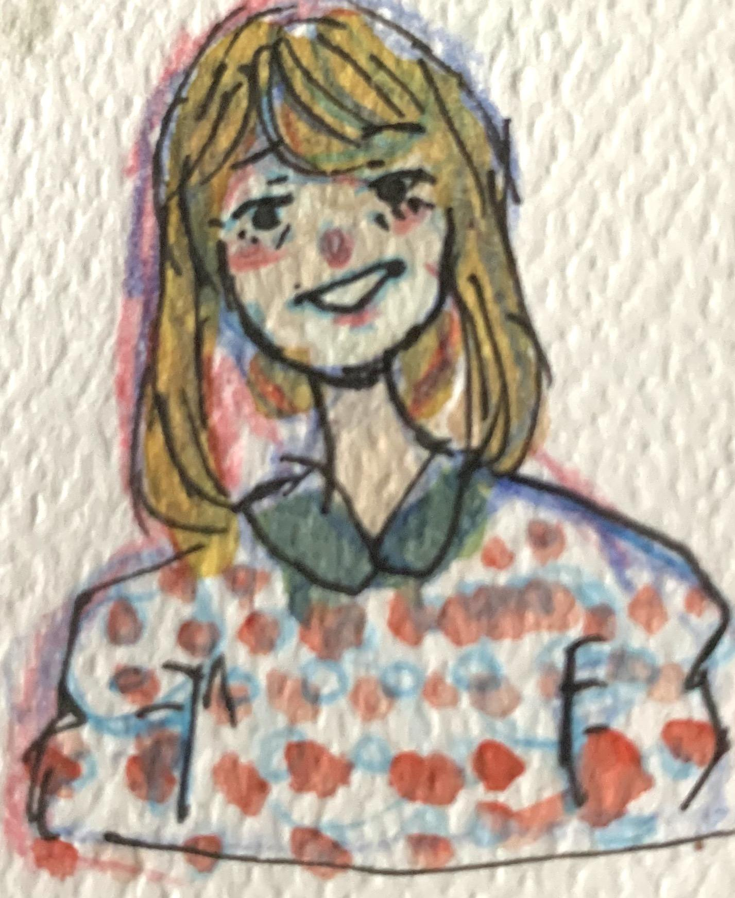
Scene 1
This is the first scene in the book and that’s not the only reason why I chose this scene. Other than first impression this is the first scene we see of one of aunt Lena’s ideas to protect Katarina. Oh! How rude of me I forgot to mention what is going on. Aunt Lena is applying an ointment that will make Katarina’s face red which will make doctors and other higher ups think Katarina is too sick to be sent to the work camps.

Slide 5
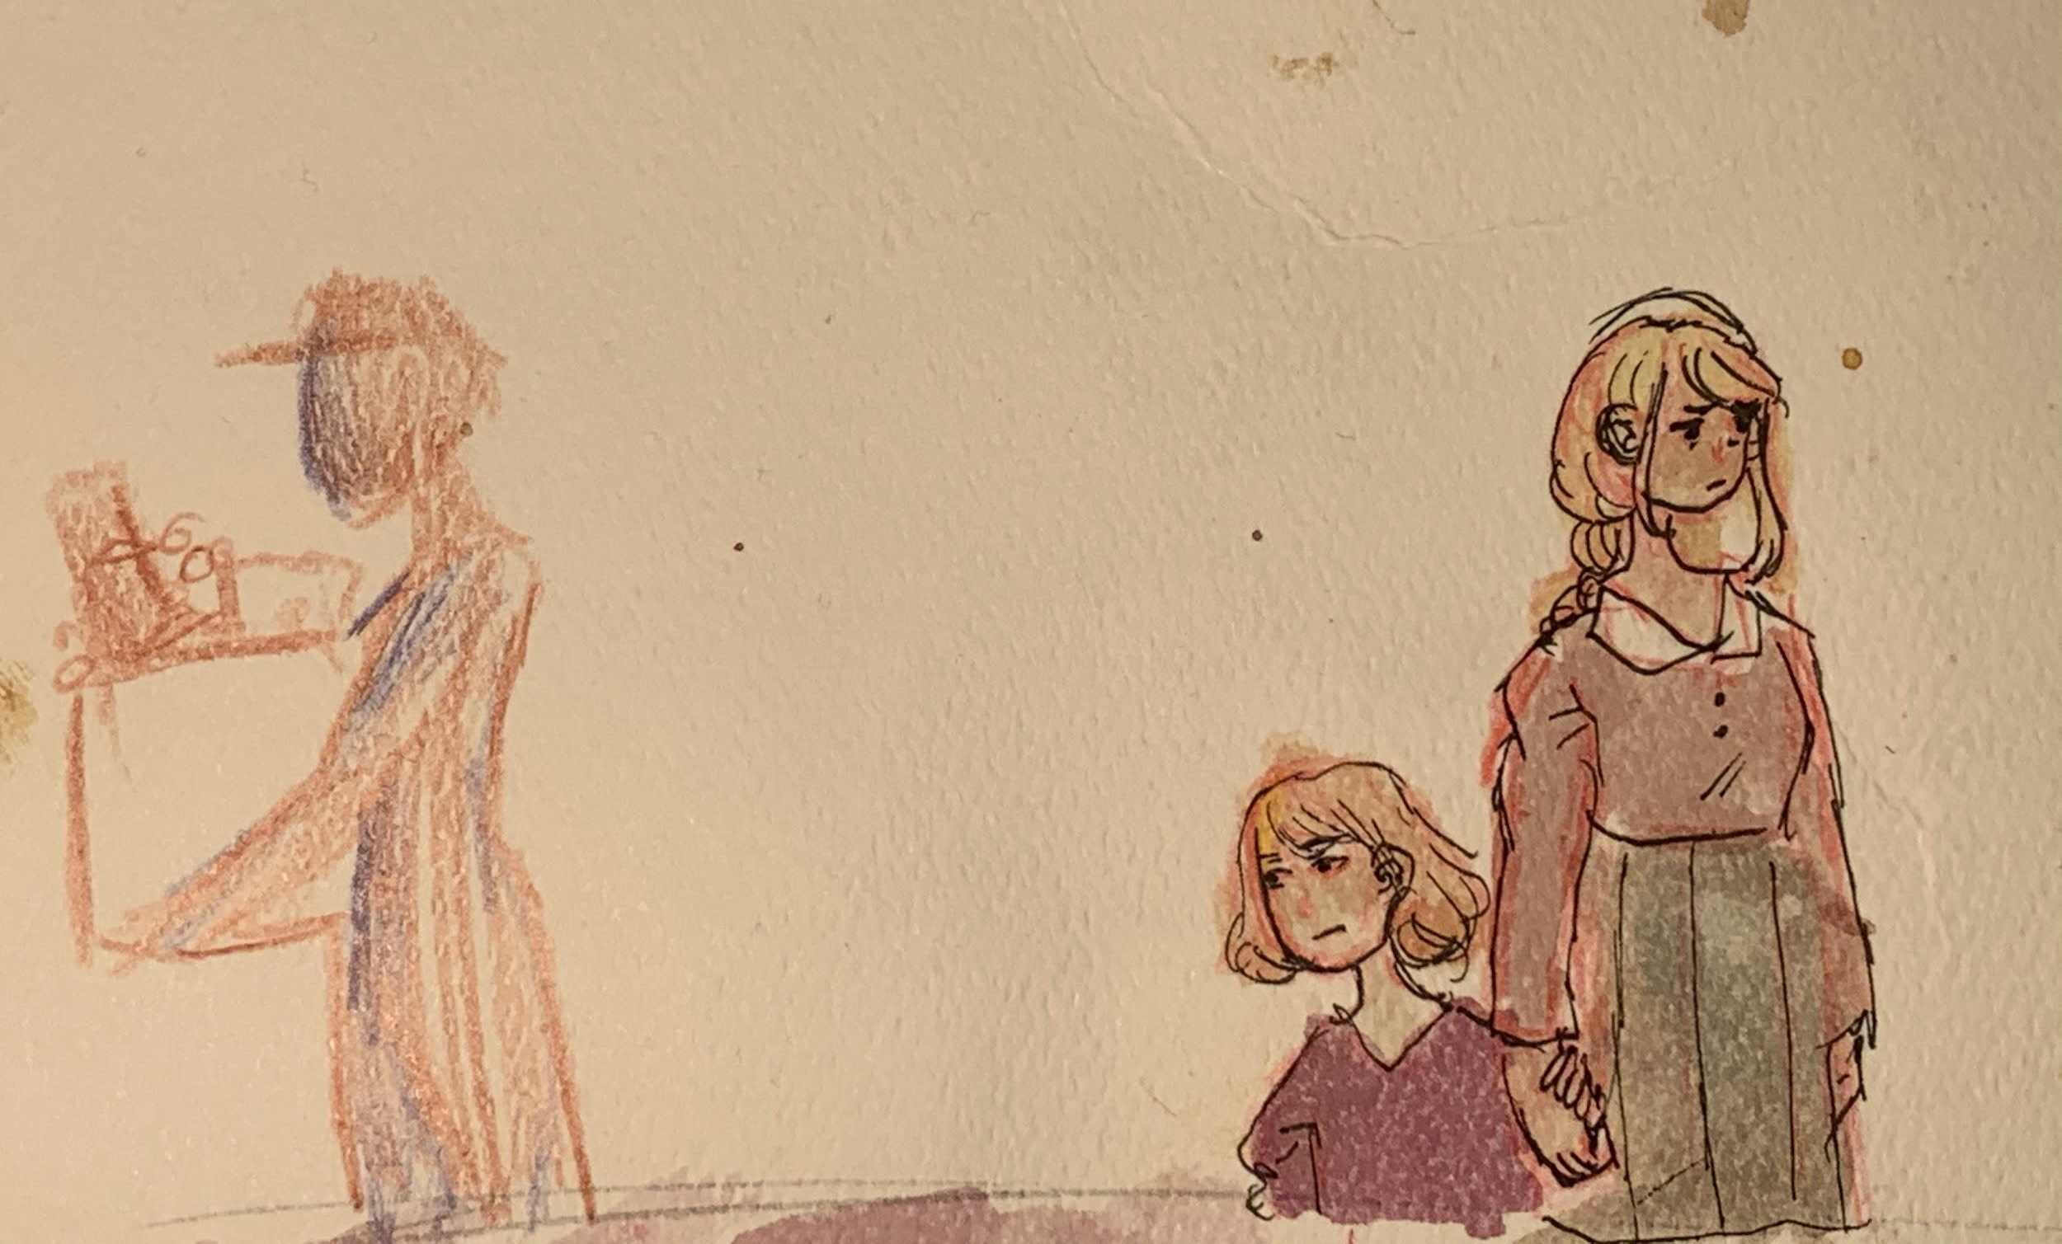
Scene 2
In this scene people come to Katarina’s house and take away many of her belonging. From her perspective she is bitter and watches as her beloved belongings are taken away. But I believe this is the first scene where the reader may start to worry what the future holds for Katarina.

Slide 6
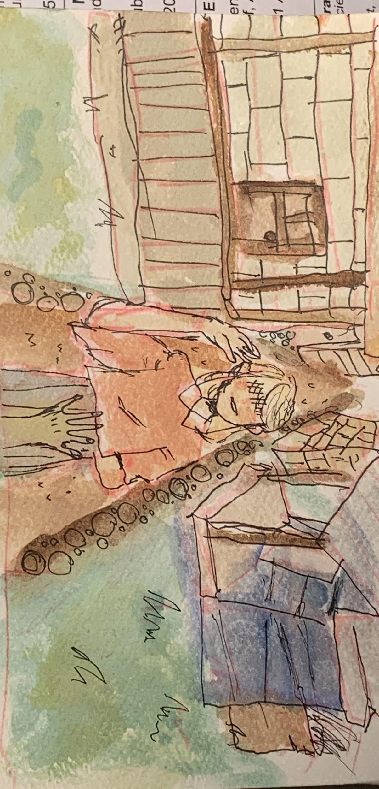

Slide 7
Scene 3
The scene I drew was when Aunt Lena payed a teen girl named Mariška to be the guardian of Katarina for a supposed three month. But Katarina knew that it was all a lie, Aunt Lena lied so she could find a safer place in Hungary and then come back for Katarina . But the story Aunt Lena told Mariška was that she fell ill and had to go to a hospital far away and couldn’t take Katarina. Not only that but Katarina is under a fake identity because of the whole Jewish thing. To Mariška Katarina is suppose to be a Christian orphan. Okay, I lied earlier the scene I actually drew was when Katarina was riding away from Aunt Lena after saying their goodbyes. Let me tell you just a little more about Mariška, she lives in a household of many siblings I believe nine, and her father. After her mother died her dad became an alcoholic and would sometimes get violent. This left a lot of the work on Mariška to make money a provide for her sidling.

Slide 8
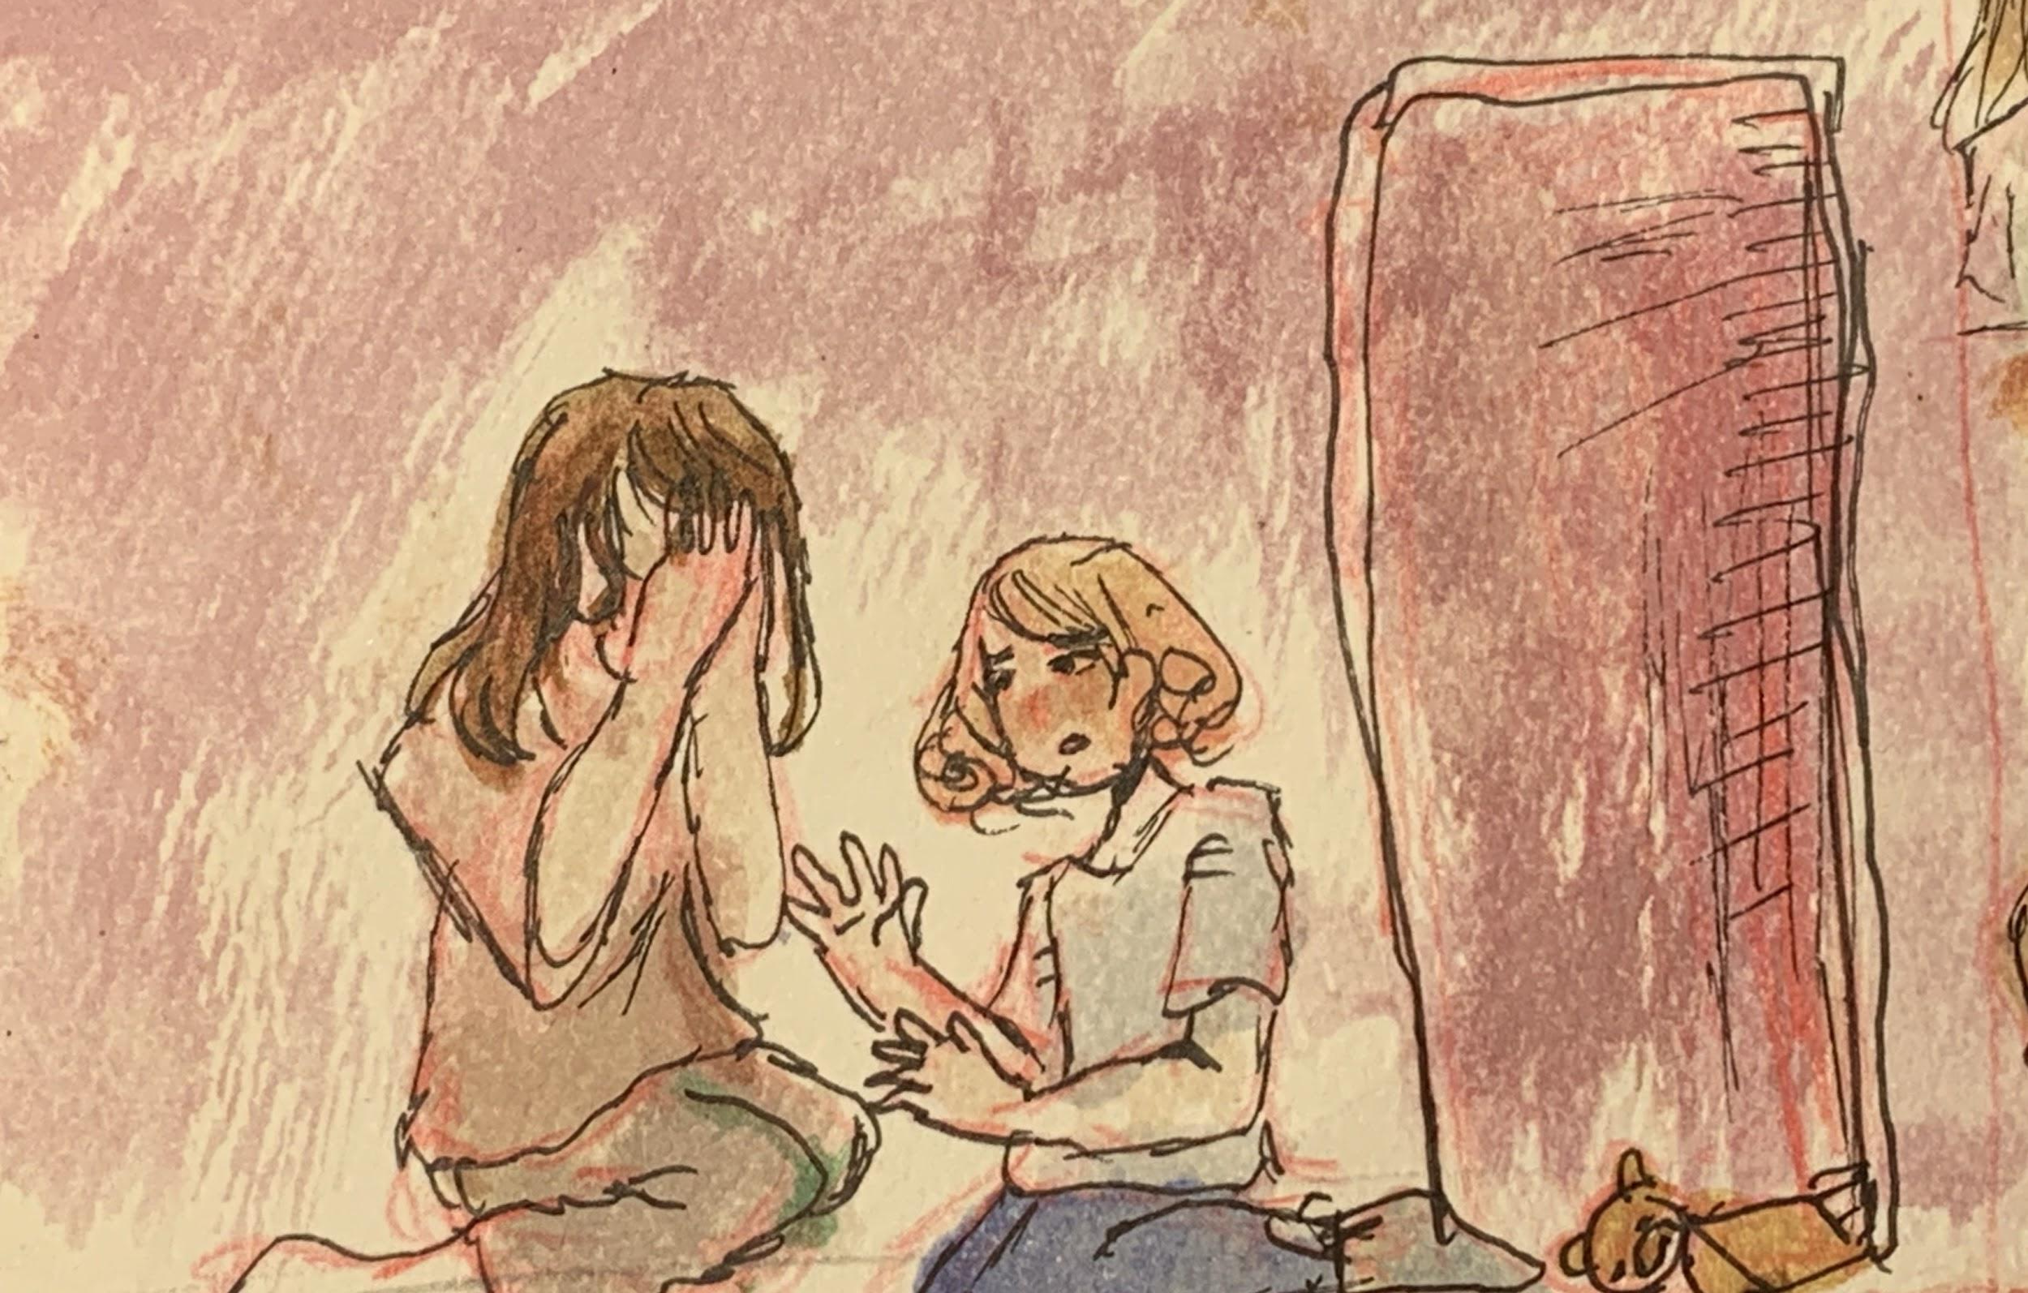
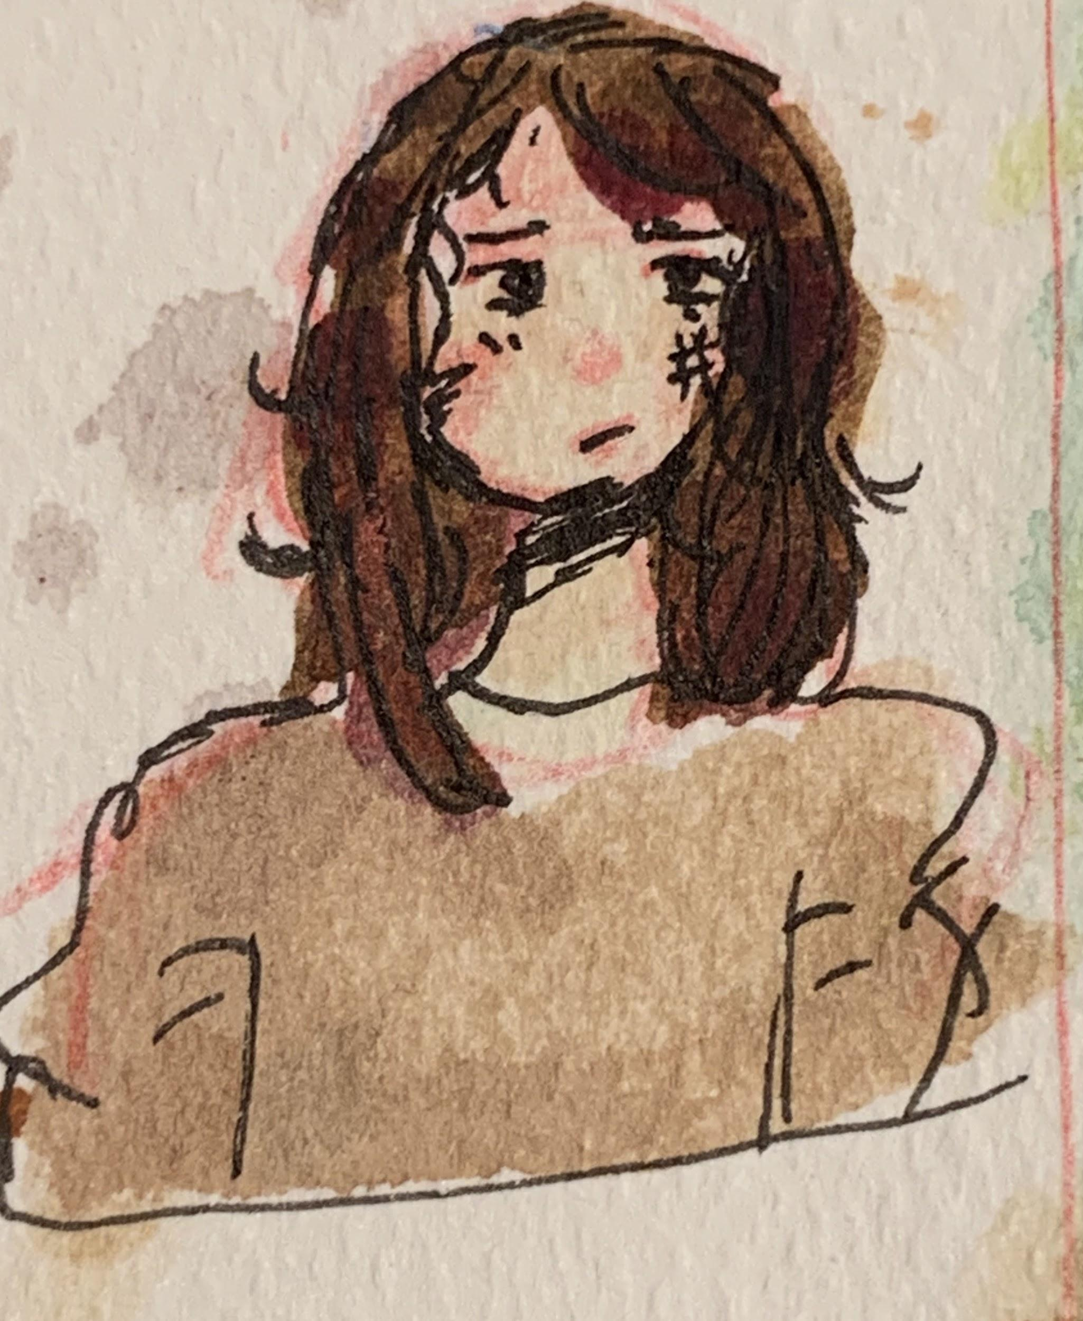
Scene 4
In this scene Mariška and her whole town find out Katarina’s identity. But right before Katarina is sent away Mariška has a sudden feeling of guilt and lets Katarina stay. She keeps Katarina in a pantry to keep her hidden. But her father gets suspicious and threatens Mariška to show him what is in the pantry. Mariška refuses but in turn she gets beaten. After she went to Katarina and told her she needed to leave.
MARIŠKA

Slide 9
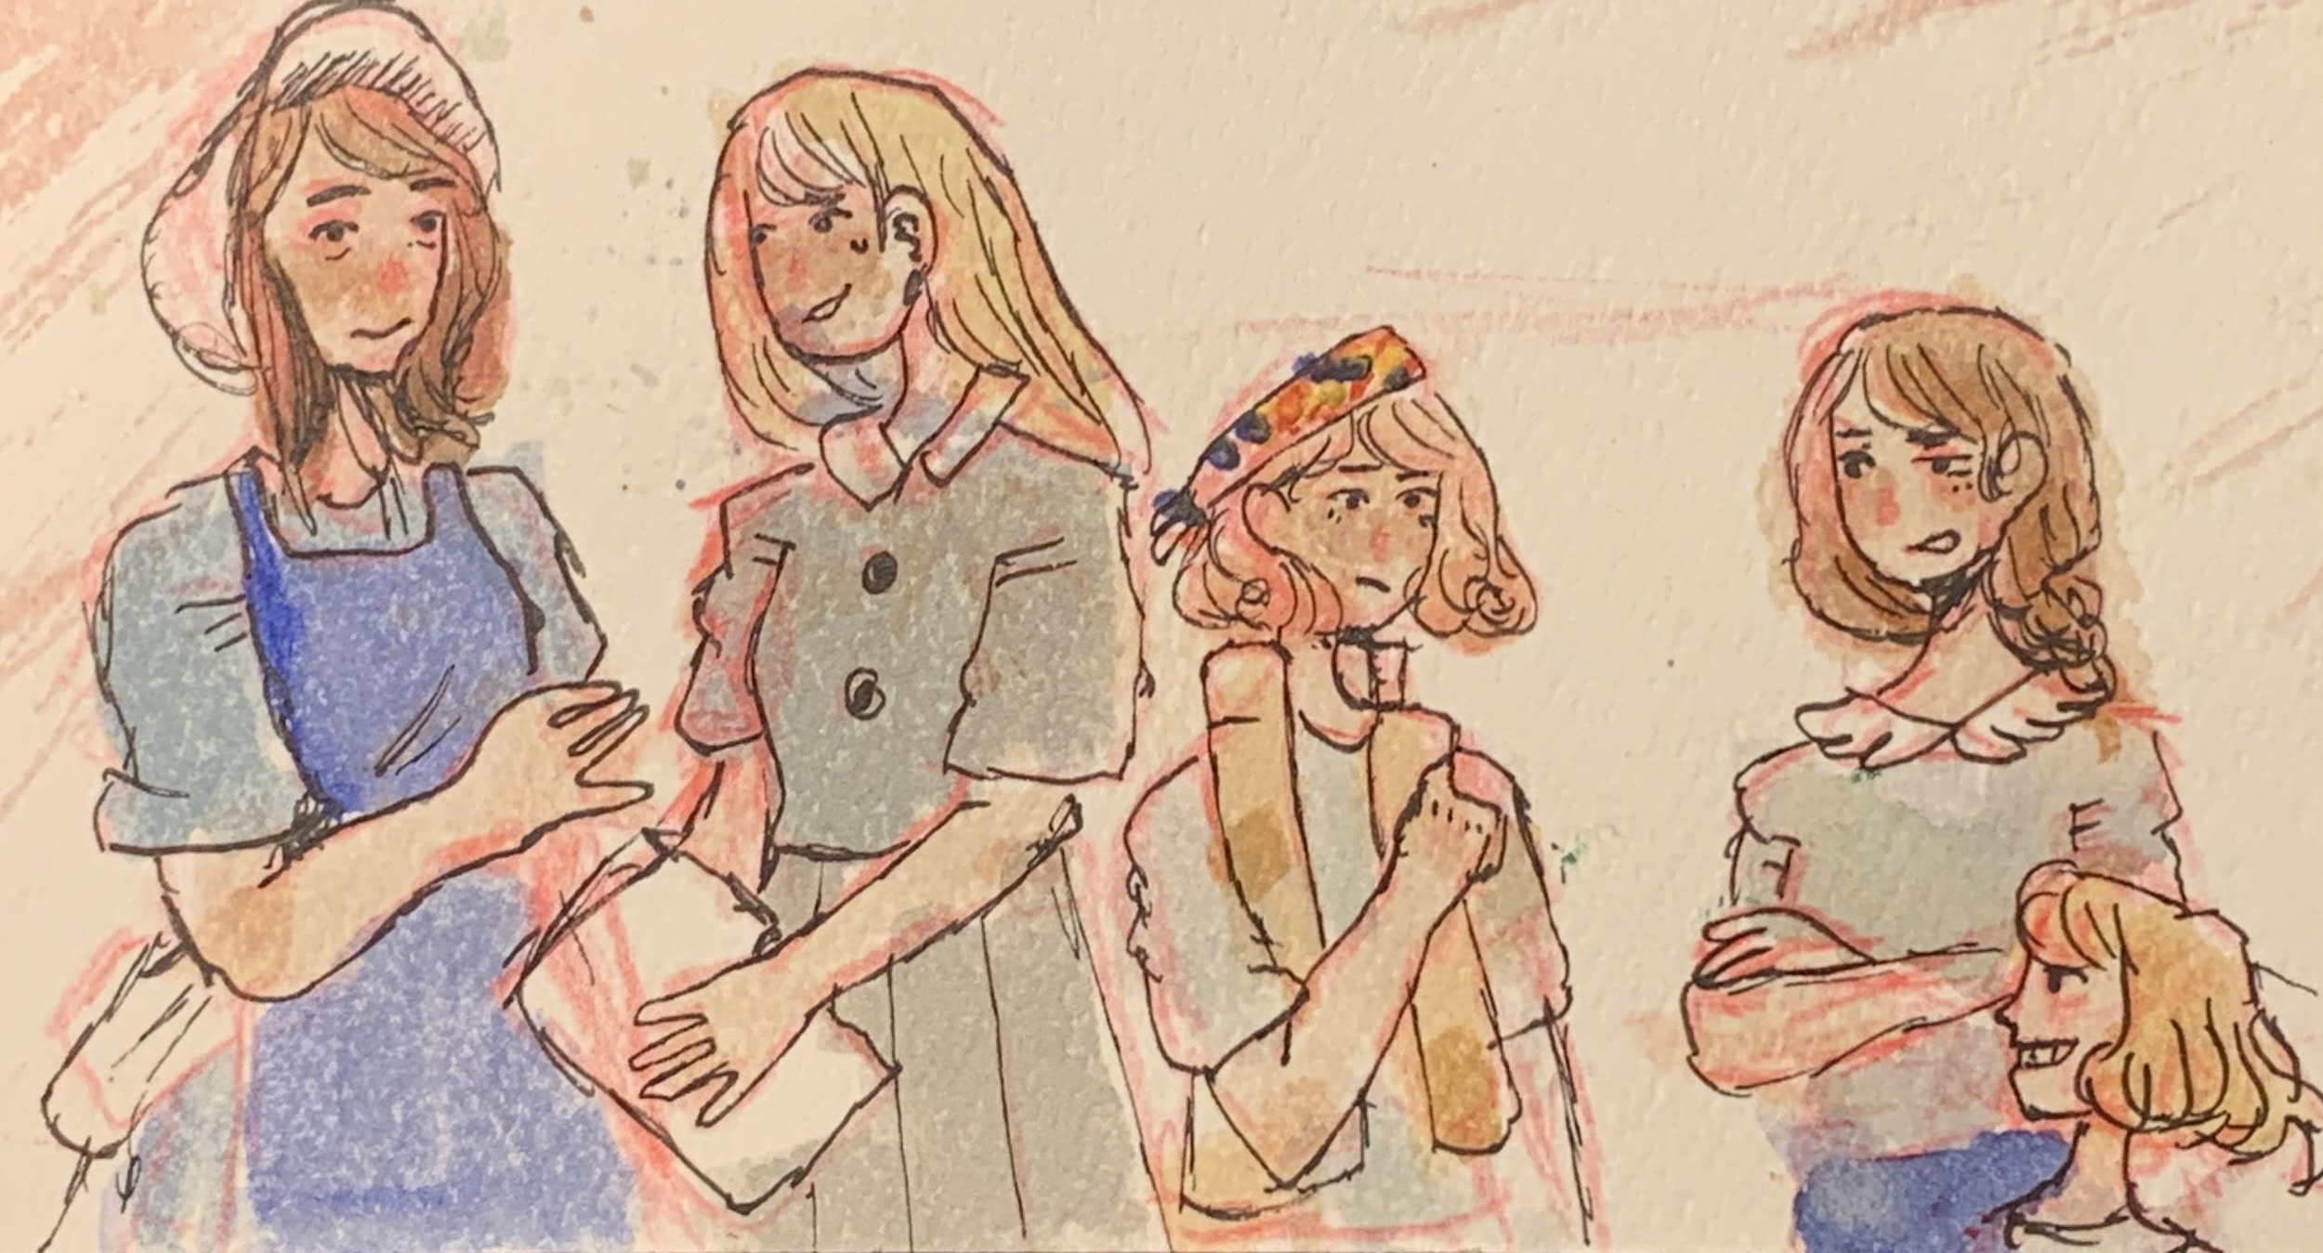
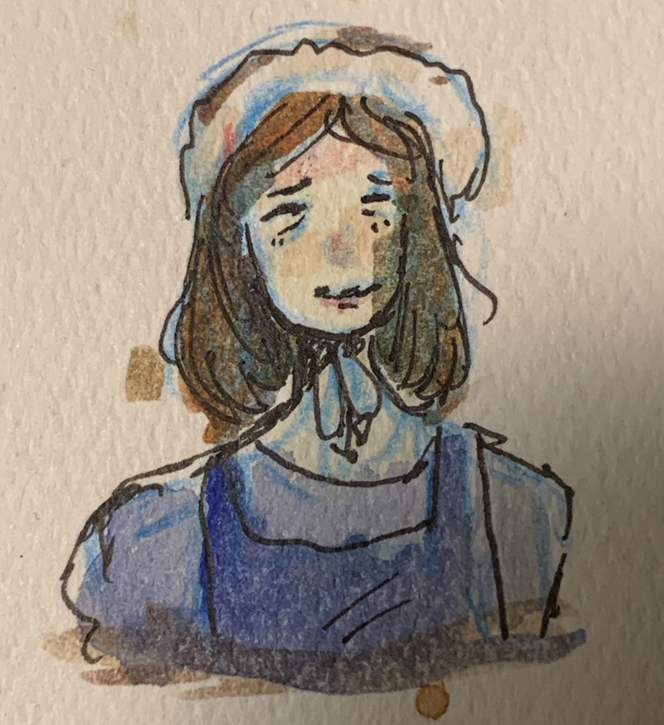
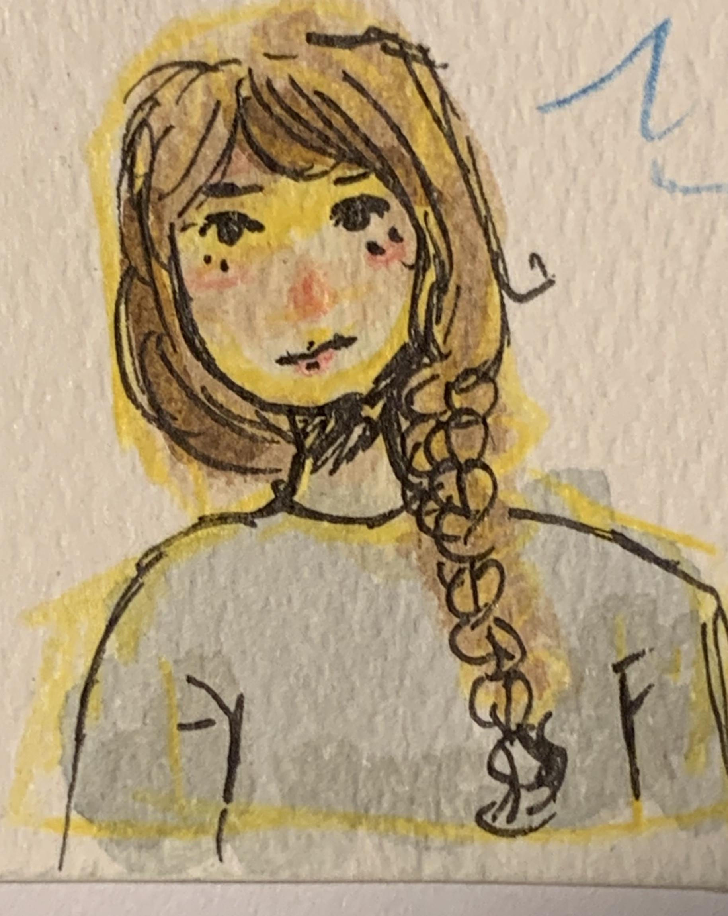
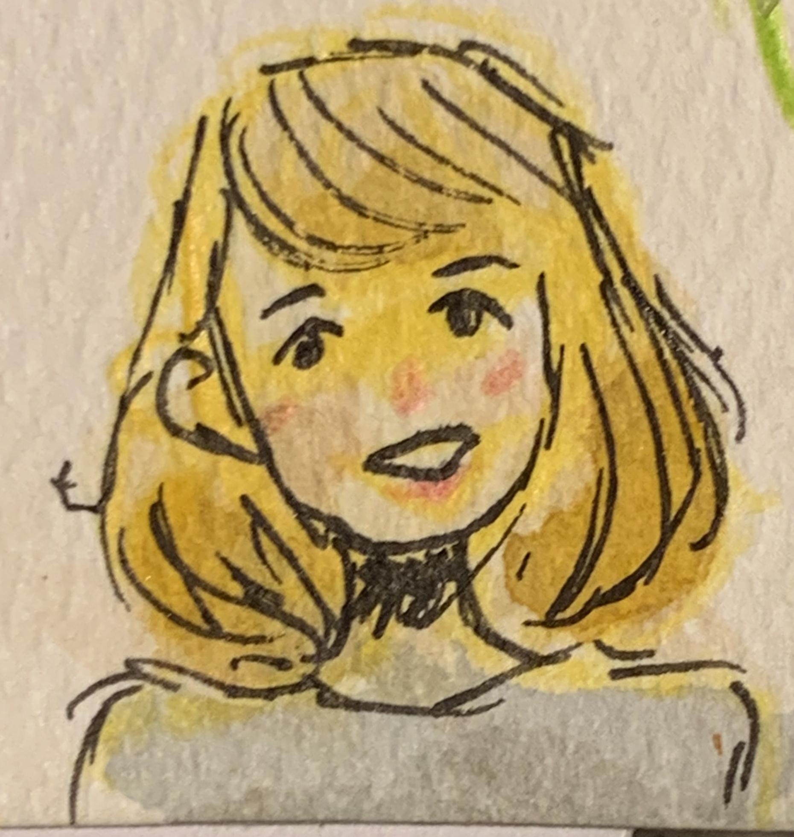
Scene 5
After Katarina is kicked out she goes to her old maid’s house Anka who she admires. Her family does not want to take her in, so Anka is forced to bring Katarina to a orphanage under a fake identity. She would be known as a orphan partisan. Anka tell Katarina to keep quiet, before two orphan girls named Vlasta and Betka approach her. They question Katarina for a bit then start teasing her after not answering any of their questions.
Sister Mara
(Orphanage worker
Anka
Vlasta Betka

Slide 10
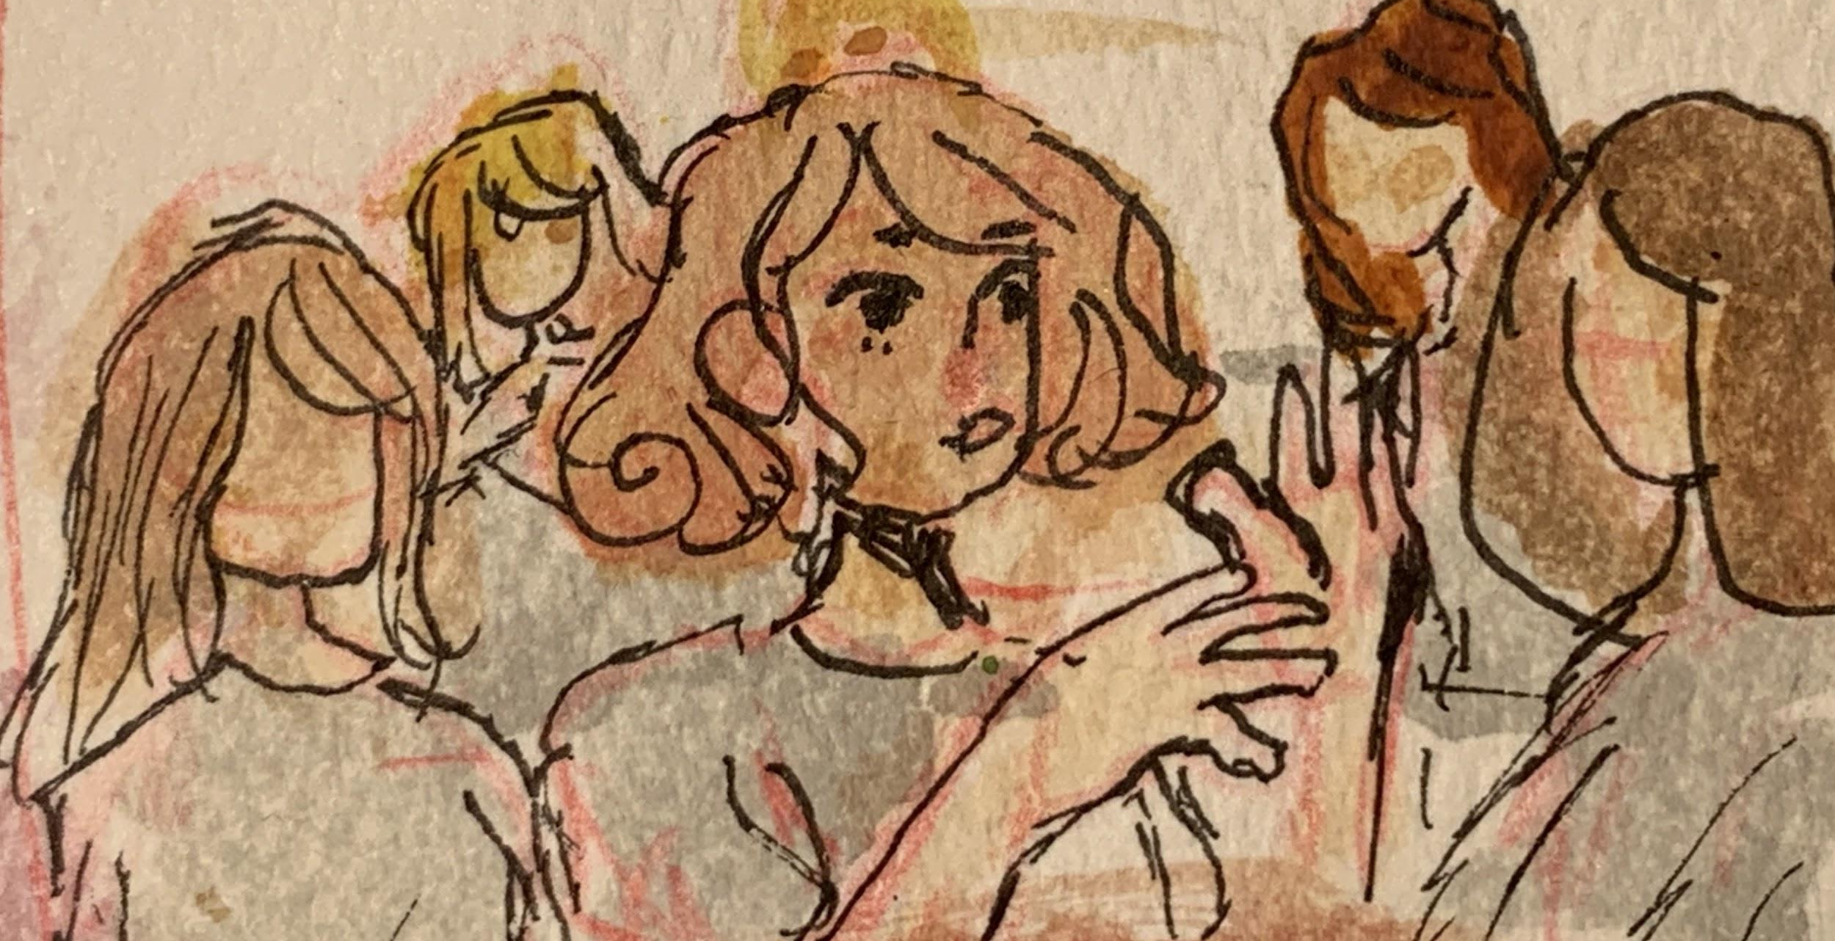
Scene 6
This scene is when Katarina starts to believe that her purpose for being at the orphanage is to teach the Christian religion. By accident she actually accomplishes this. I found this very interesting because this was before things started getting bloody so I wonder if what she taught those orphan children gave them a shred of hope during the hard times. This is also something that played a big part in making Katarina more social than before and In turn giving her fond memories for her to look back on.

